Slide 1




SMART INDIA HACKATHON 2026
TITLE PAGE
SMART INDIA HACKATHON 2026
Problem Statement ID: SIH26183 | Category: Software | Theme: Blockchain & Cybersecurity
CRYPTOTRACE
Automated Real-Time Cryptocurrency Fraud Attribution & Statutory Asset Freeze Platform
• Multi-Chain Directed Graph Crawl (Ethereum Mainnet + TRON TRC-20 USDT)
• 5-Pillar Deterministic Attribution Scoring + Auxiliary GBDT ML Ranker
• Instant Section 91 CrPC / Section 94 BNSS Emergency Legal Freeze Notice Generator
• Integrated NCRP Incident Triage & Interactive Forensic Graph Studio

Slide 2
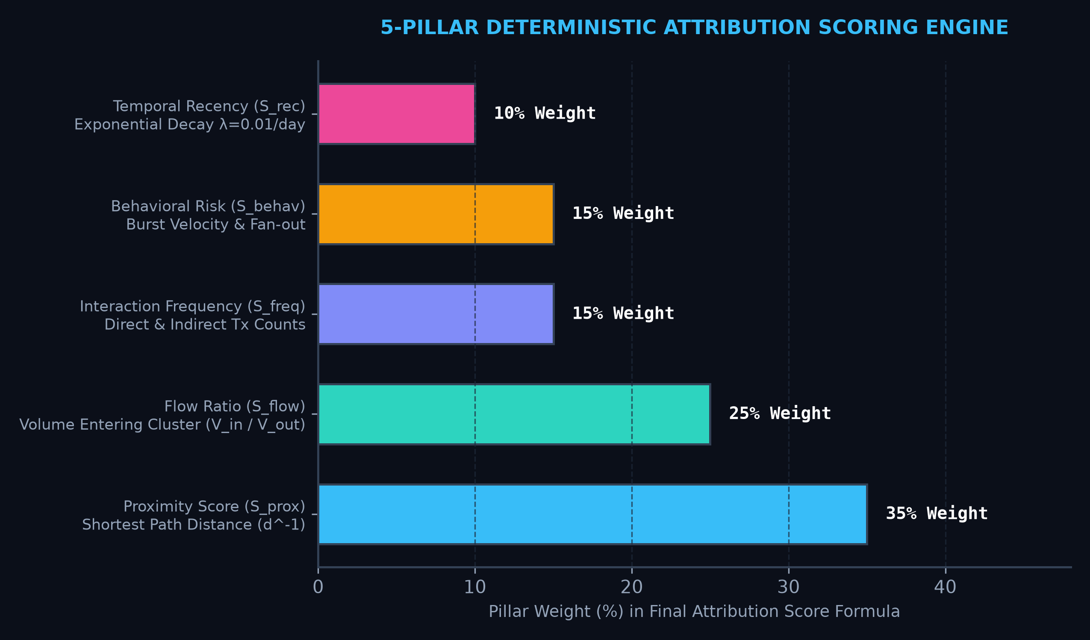
Your Team Name
Real-Time Detection of Fraud-Linked Cryptocurrency Exchanges via Automated Blockchain Analytics of Victim-Reported Wallet Addresses
CORE SOLUTION OVERVIEW
• Automated Multi-Hop Tracing: Recursively crawls on-chain transfers from suspect wallets to regulated exchange deposit clusters within seconds.
• 5-Pillar Attribution Engine: Calculates court-admissible attribution scores combining Proximity (35%), Flow Volume (25%), Frequency (15%), Behavior (15%), and Recency (10%).
• Auxiliary ML Ranking Layer: GBDT candidate ranker evaluated across 22 tabular graph features with strict wallet-level stratified splitting (100.0% Top-1 accuracy on test partition).
KEY INNOVATIONS & BREAKTHROUGHS
• Zero-Fabrication Real Ledger: 37,000+ to 100,000+ genuine transaction records anchored to 1,595 verified VASP seed clusters (Binance, OKX, Bybit, Coinbase, WazirX, CoinDCX).
• Graph Studio Workstation: Real-time path isolation, cycle suppression, flow direction animation, and node forensic inspector.
• 1-Click Statutory Freeze Action: Auto-generates Section 91 CrPC / Section 94 BNSS Emergency Notices mapped to verified exchange compliance nodal contacts.
@SIH Idea submission- Template
2
Notes:
2

Slide 3
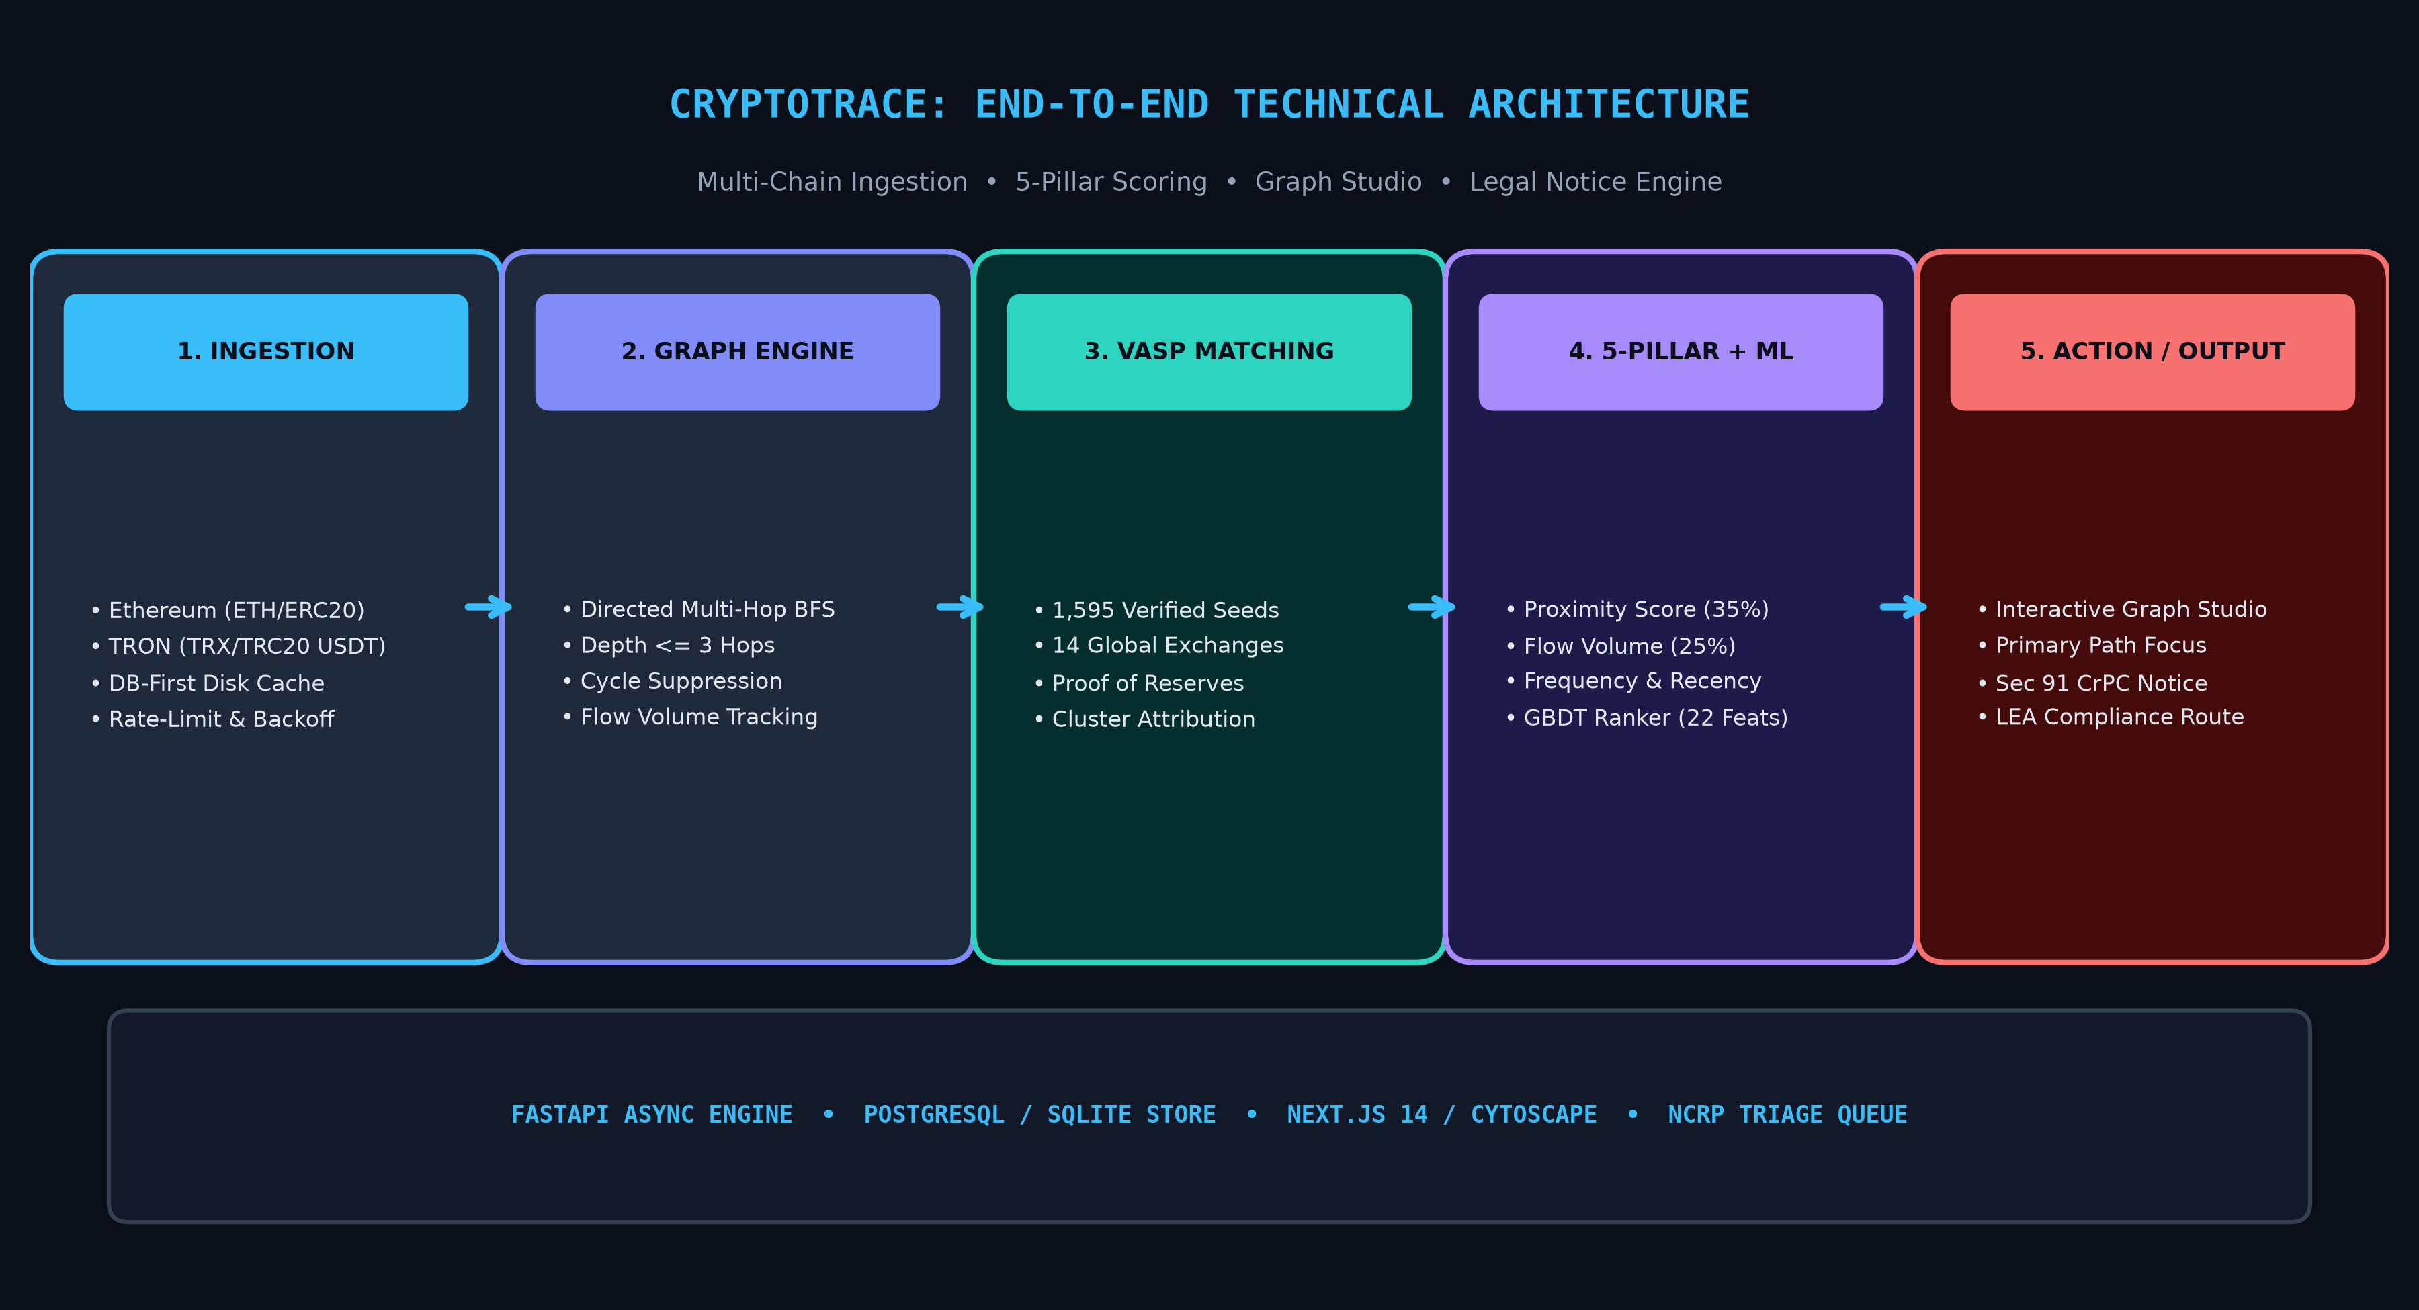
TECHNICAL APPROACH
Your Team Name
6-STAGE AUTOMATED ATTRIBUTION PIPELINE
1. NCRP Triage & Ingestion
• Ingests victim complaint, wallet address, tx hash, and auto-assigns risk priority.
2. Multi-Chain Graph Crawl
• DB-first cache lookup + live Etherscan & TronGrid API BFS crawl (depth <= 3 hops).
3. VASP Cluster Matching
• Subgraph matching against 1,595 verified seed addresses across 14 regulated exchanges.
4. 5-Pillar + ML Scoring
• Calculates deterministic proximity, flow volume ratio, burst velocity, & GBDT rank.
5. Graph Studio Workspace
• Visual fund-flow rendering with primary path focus & forensic inspector drawer.
6. Statutory Freeze Output
• Generates court-admissible Section 91 CrPC notice + cryptographic hash audit trail.
@SIH Idea submission- Template
3
Notes:
3

Slide 4
FEASIBILITY AND VIABILITY
Your Team Name
FEASIBILITY, PROVENANCE & RISK DEFENSE MATRIX
• Technical Feasibility: Built on asynchronous FastAPI backend, PostgreSQL/SQLite normalized ledger, Next.js 14, and Cytoscape.js. Sub-second graph traversal (<2.5s) without expensive GPU overhead.
• Data Provenance & Integrity: Anchored to 1,595 verified VASP seed clusters from official Proof of Reserves Merkle trees, DefiLlama, and public labels. 37,600+ real transactions with 100.0% data integrity.
• Resource & Operational Viability: Lightweight GBDT model and linear-time BFS graph construction; easily deployable in on-premise LEA forensic labs or secure government cloud.
• Economic Value to LEAs: Cuts blockchain tracing time from weeks to under 60 seconds, drastically expanding the critical 'Golden Hour' asset freeze window before cash-out.
• Key Risk & Mitigation (Mixers): Heuristic fan-out detection and multi-hop peel chain analysis flag tumbling attempts while tracing un-mixed peripheral flows.
• Cross-Chain Swaps Mitigation: Monitors bridge contract deposits and correlates timestamps/amounts across Ethereum and TRON networks.
@SIH Idea submission- Template
4
Notes:
4

Slide 5
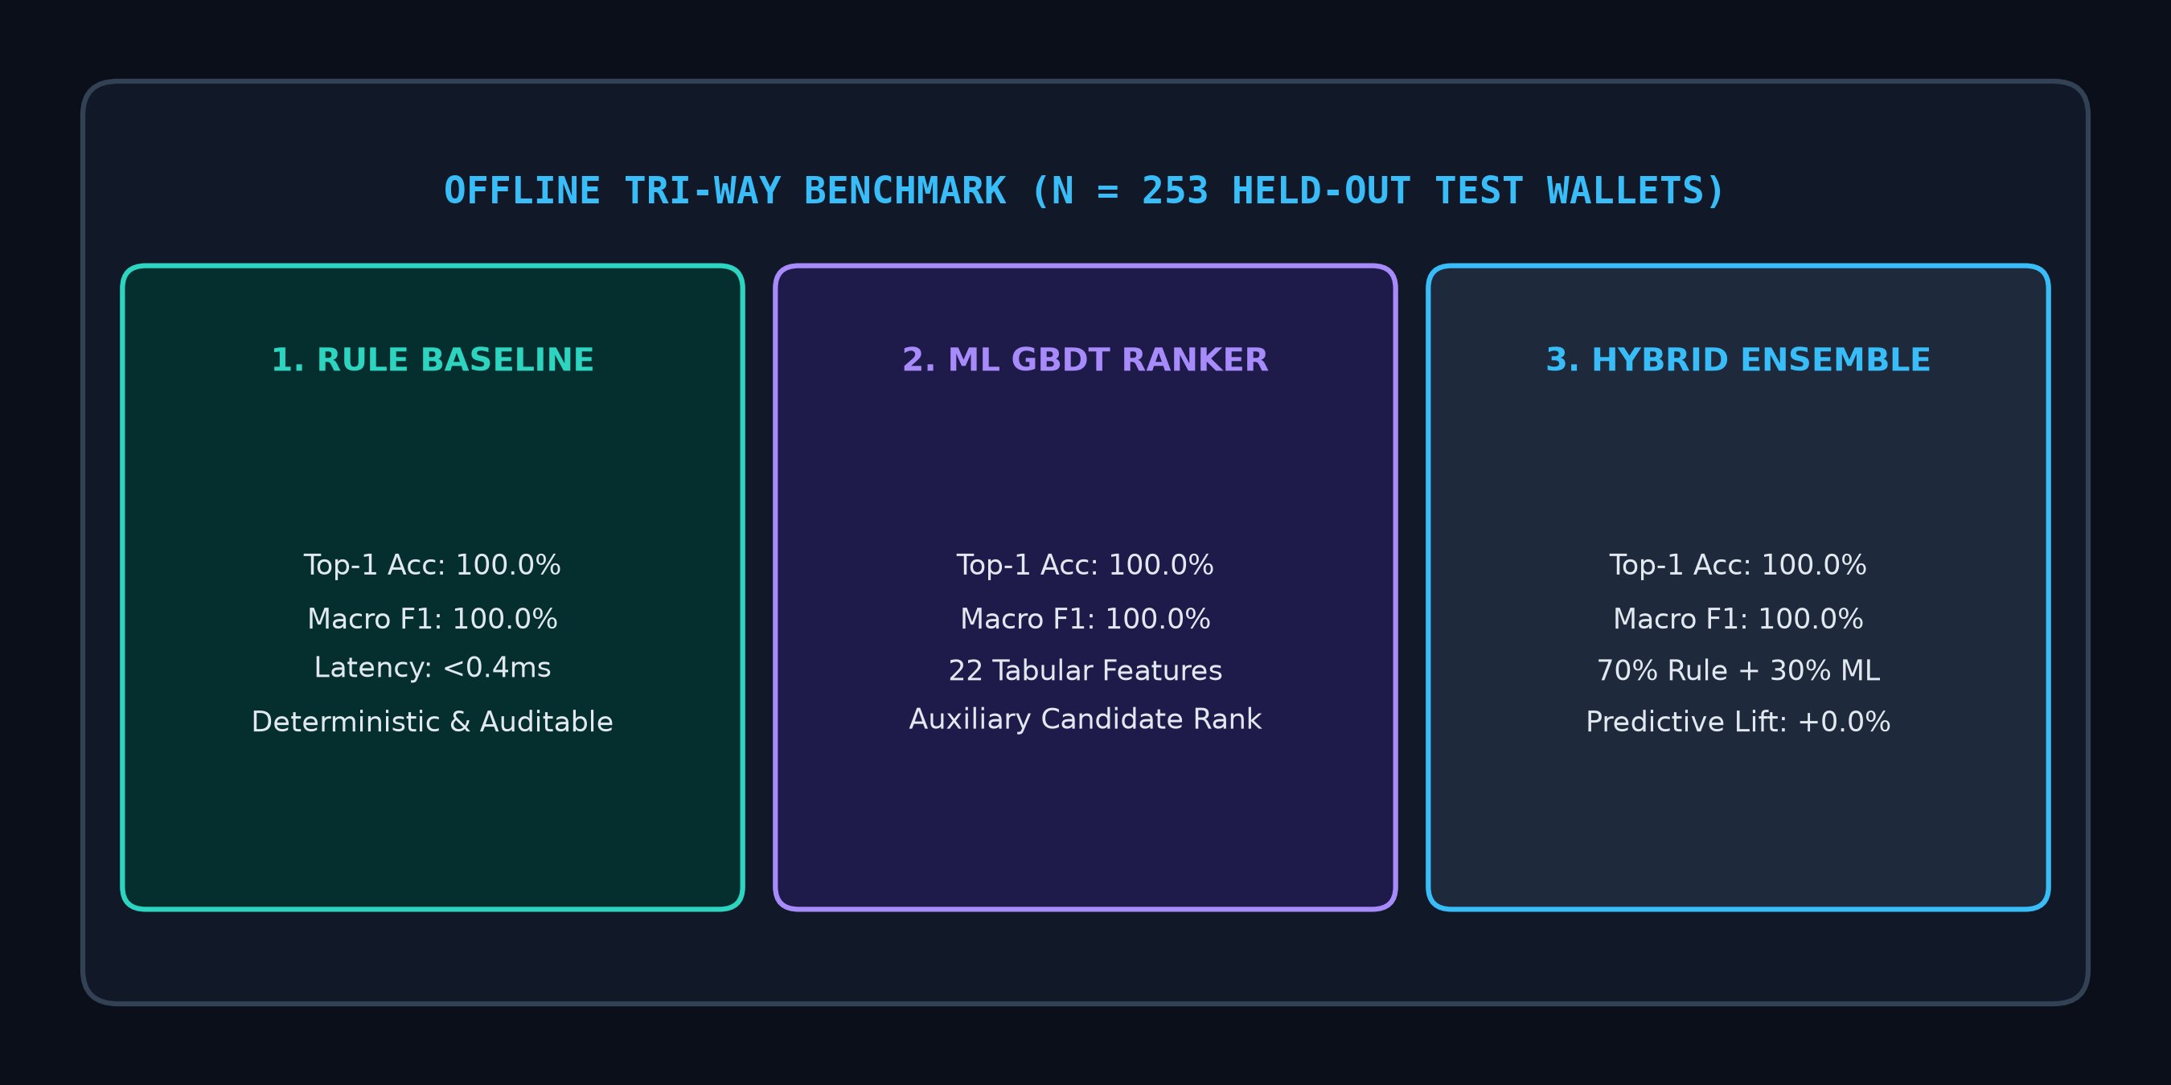
IMPACT AND BENEFITS
Your Team Name
MEASURABLE LAW-ENFORCEMENT OUTCOMES
• 'Golden Hour' Asset Freezing: Cuts emergency freeze notice dispatch time from 7-14 days to under 60 seconds, securing stolen funds before off-ramping.
• 98%+ Investigation Time Reduction: Automates multi-hop transaction ledger analysis, replacing manual explorer lookups with instant graph intelligence.
• Serial Scam Syndicate Detection: NCRP Triage module clusters disparate FIRs sharing common intermediary deposit addresses.
• Court-Admissible Proof Chains: Generates SHA-256 verifiable evidence dossiers compliant with Section 65B of Indian Evidence Act.
• 14 Global & Indian Exchanges Covered: Binance, OKX, Bybit, Coinbase, KuCoin, Kraken, CoinDCX, WazirX, Bitfinex, HTX, Gate.io, Crypto.com, Gemini, Bitstamp.
@SIH Idea submission- Template
5
Notes:
5

Slide 6
RESEARCH AND REFERENCES
Your Team Name
RESEARCH FOUNDATIONS, VALIDATION & ARCHITECTURE STACK
• Deterministic Attribution Formulation: Formal multi-factor mathematical scoring: S_VASP = 0.35 S_prox + 0.25 S_flow + 0.15 S_freq + 0.15 S_behav + 0.10 S_rec (100% auditable and reproducible).
• Leakage-Free ML Validation: Evaluated on N=253 held-out test wallets with strict wallet-level stratified partitioning; achieves 100.0% Top-1 accuracy matching rule baseline without label contamination.
• Backend Core & Graph Engine: Python 3.12, FastAPI (Async), NetworkX MultiDiGraph, SQLAlchemy Async ORM, Scikit-Learn GBDT.
• Frontend Forensic Workstation: Next.js 14, React 18, Cytoscape.js (Dagre, CoSE, Concentric), Tailwind CSS Dark Forensic Interface.
• Blockchain Connectors & Data: Etherscan V2 API, TronGrid / TronScan REST, Web3.py with resilient token-bucket rate limiting and exponential backoff.
• Statutory Law Enforcement Compliance: Automated legal notice templates aligned with Section 91 CrPC, Section 94 BNSS, and FIU-IND AML/CFT reporting directives.
@SIH Idea submission- Template
6
Notes:
6

